Slide 1
Azure Training Day Learn, architect and develop solutions on Azure

Slide 2

Presentation title
Let’s get Started!
Tell us what you think by completing our survey
Schedule a post-event session to address your specific requirements.
Speaker name
Title
Learn more : aka.ms/techdocs
Get certified : aka.ms/microsoftlearn
Sign up Developer newsletter: aka.ms/usdevconnect

Slide 3


About Me…
Peter De Tender – MCT, Azure MVP
CEO and Lead Technical Trainer of 007FFFLearning.com, +20 years IT experience, mainly datacenters and Microsoft Infrastructure background
Full-time in Azure since 2013 (Readiness & Architect)
Azure Advisor, Azure Certified Architect
Technical Writer, Book author, Courseware Creator
Living in Belgium, but traveling worldwide 90% of my time, helping larger Microsoft Partners, customers and Microsoft FTEs in learning about and using Azure, by providing workshops with passion
peter@pdtit.be
@pdtit @007FFFLearning
http://www.facebook.com/pdtit
http://www.linkedin.com/in/pdtit

Slide 4
Workshop delivery
For the technical trainers:
Each Module could be presented as a stand-alone module, although the full potential comes from delivering all modules
HOL are somehow depending on each other, starting from the IAC-lab, where students deploy the VM-based source environment, moving to WebApps, SQL PaaS, Docker, Azure Container Registry, running Azure Container Instance, and ultimately Azure Container Services with Kubernetes. (only labs that could be skipped are WebApps and AKS)
The HOL solution is based on a ASP.NET Core app « SimplCommerce » (Open Source), using SQL Database

Slide 5
Workshop delivery
For the technical trainers:
Whenever you detect any mistakes, issues, wrong wordings,… in presentations or LAB guides, please send an email to :
msdevseriessupport@007FFFLearning.com, subject « Azure Developer Series – Containers », so we can take care of this and fixing it immediately
Latest version of all content should be available on GitHub:
http://www.github.com/007FFFLearning/MSDevSeriesSupport

Slide 6
Application Migration
Migrating an ASP.NET application to Azure using different Container services
Peter De Tender
@pdtit @007FFFLearning
Aug 2019

Slide 7
Lift & Shift Migration
Efficiently Deploying and Migrating Virtual Machines to Azure

Slide 8
Infrastructure as Code (IAC)

Slide 9
http://en.Wikipedia.org/wiki/ Infrastructure_as_ Code
What is Infrastructure As Code (IAC)
The process of managing and provisioning computer data centers through machine-readable definition files.
The deployment can use either scripts or declarative definitions, rather than manual processes.
While the terminology points to Infrastructure, it should not be confused with Infrastructure as a Service (IaaS), as IAC also allows you to deploy other (cloud) components like Platform as a Service (PaaS)

Slide 10
Infrastructure As Code (IAC) - Values
1. Faster execution
Build once – Deploy many
Minor changes required to deploy different models
Deployment of compute resources goes faster than manual provisioning
2. Reduce risk
Remove Errors and Mistakes
Remove Security Violations
Overwrite changes without touching existing deployment state
3. Reduce cost
Manual labor is expensive
Easily scale out your environment
Portable across different environments (dev/test/staging/different organizations)
4. Integration with devops
Infrastructure as Code provides an integration with DevOps concepts and processes within an organization
Allows for end-to-end application landscape provisioning, not just ‘infrastructure’

Slide 11
Infrastructure As Code (IAC) - Methods
Declarative (functional) “WHAT”
The final state of the system / environment is defined (declared), in such a way that it defines in “what” state it should be.
When the process is run, it will configure the system/environment to have the declared state as the final result.
AUTOMATION
Imperative (procedural) “HOW”
The automation code used to setup or configure the system / environment is written in such a way, it goes through each configuration step-by-step.
Automation code built in this way, defines the process of “how” the system is to be configured and what steps need to be taken, in the exact order, to obtain the final result state.

Slide 12
Infrastructure As Code (IAC) – Configuration Options
Configuration orchestration
Designed and used to automate the deployment of servers and other related (cloud) infrastructure
Some tools have overlap with configuration management
AUTOMATION
Configuration management
Designed and used to automate the configuration of systems and software on top of the infrastructure which has already been provisioned (out of configuration orchestration)
Some tools have overlap with configuration Orchestration

Slide 13
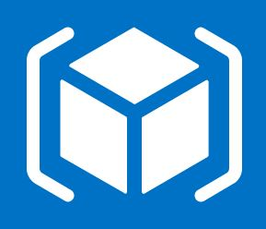
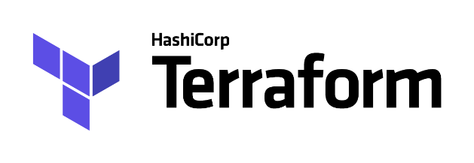
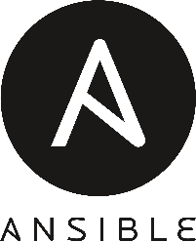
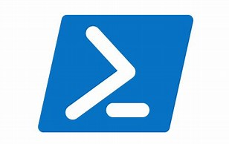
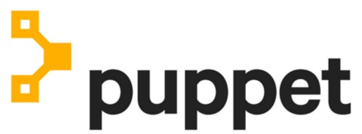


Infrastructure as Code – Tools (Azure Popular)
Configuration orchestration
Configuration management

Slide 14
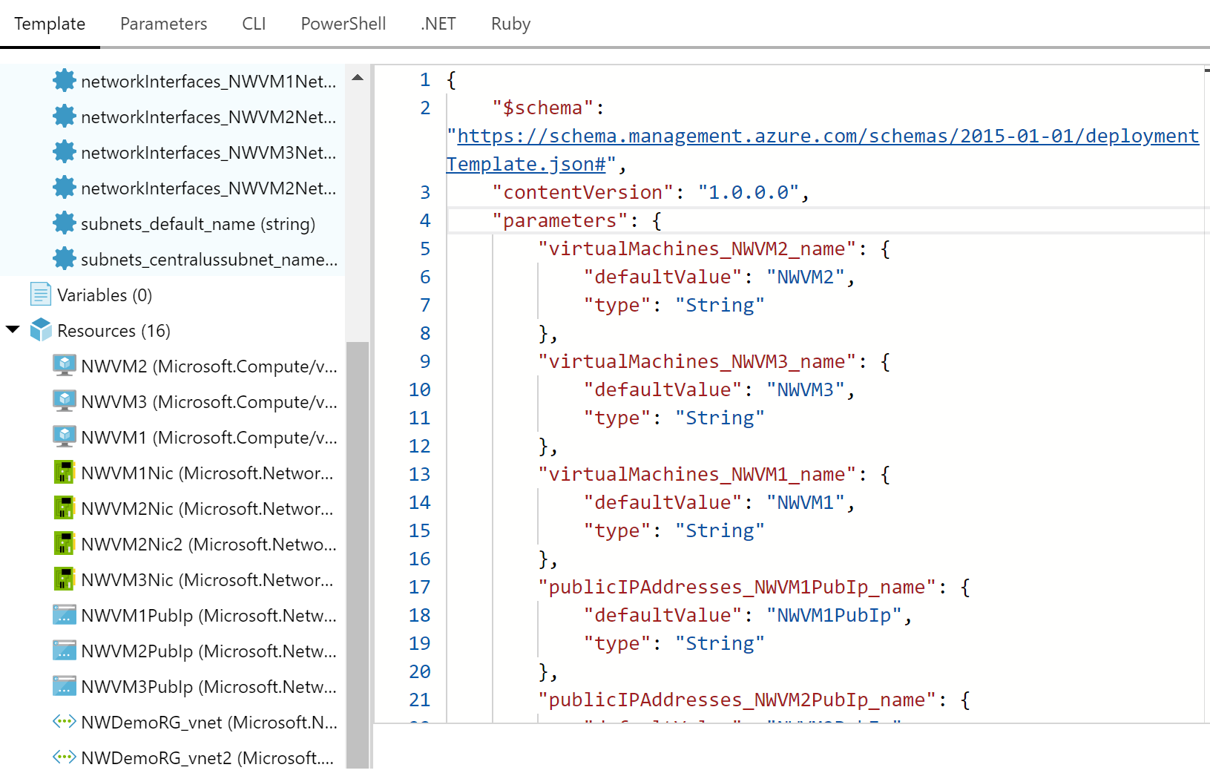
Azure Resource Manager Templates
ARM templates are based on JSON syntax

Slide 15
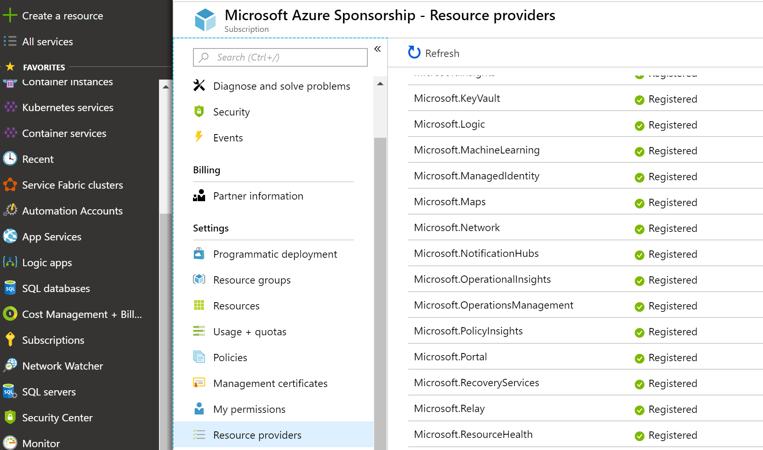
Azure Resource Providers
Resource providers registered for use with your subscription can be found in the portal (or via PowerShell, REST API, or CLI).

Slide 16
Why use ARM Templates?
Include the configuration of Azure resources in source control (“Infrastructure as Code”)
Repeat the deployment process numerous times
Automate deployments
Employ continuous integration techniques
Utilize DevOps principles and practices
Repeatedly utilize testing infrastructure then de-provision it when finished

Slide 17
Ways to create an ARM Template (…What works for Peter…)
From the automation script available from the Azure Portal (which is imperfect – more on that in a moment)
An ARM template in Visual Studio / Visual Studio Code
QuickStart Templates from GitHub (there’s a lot to choose from – the templates that start with 101 are less complex)
Create from the ground up
Start with a combination of 1 and 2 or 3, customizing the way you like it

Slide 18
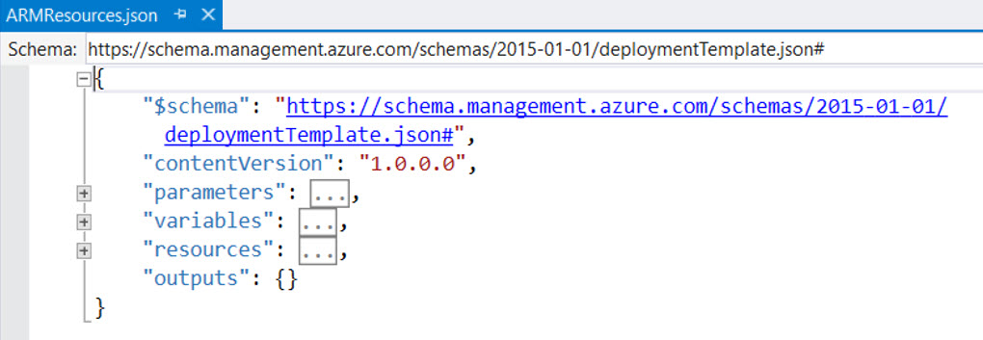
Basic Template Structure: $schema
This refers to the JSON schema. Note that the schema specified is different in the parameters file vs. the main ARM deployment file.

Slide 19
Basic Template Structure: Contentversion
You can increment this version if you’d like to manage the changes made over time. The default is “1.0.0.0.”

Slide 20
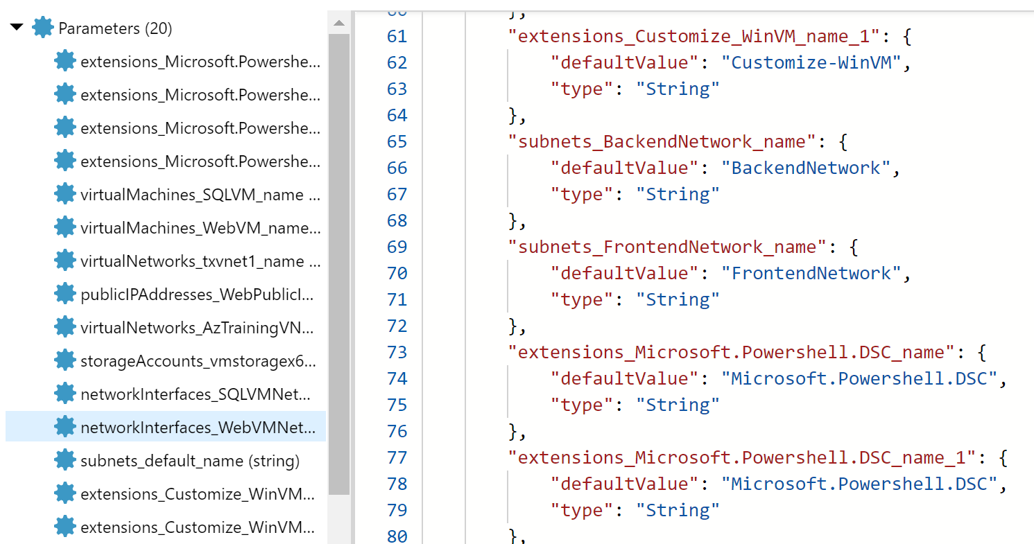
Basic Template Structure: Parameters
This is where you store the definitions of all parameters used throughout the ARM template
Type
Most common types are string or int;
Password = securestring;
MetaData / Description
Helpful info to remember what it’s used for, or any other notes you want to leave for yourself and your team.

Slide 21
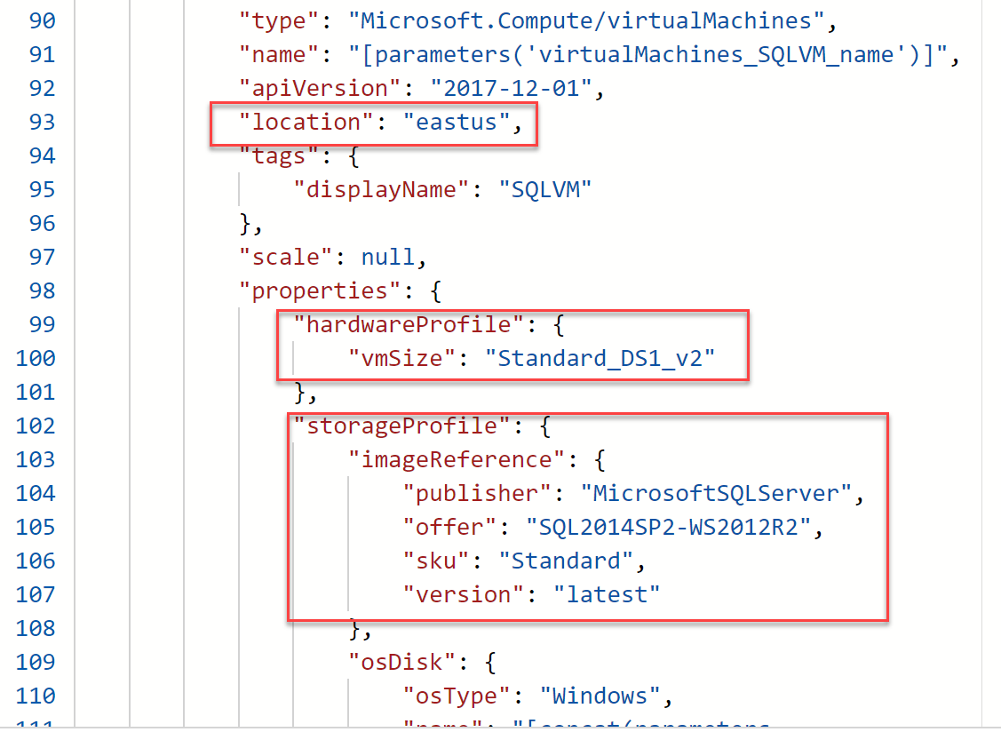
Basic Template Structure: Parameters
This is where you store the definitions of all parameters used throughout the ARM template
Allowed Values
Provides a list to choose from (e.g. restrict list of VM Sizes)
Default Value
Specifies the default value, but leaving choices (e.g. deploy DS2_v2 as VM size, but one can choose another from the list)

Slide 22
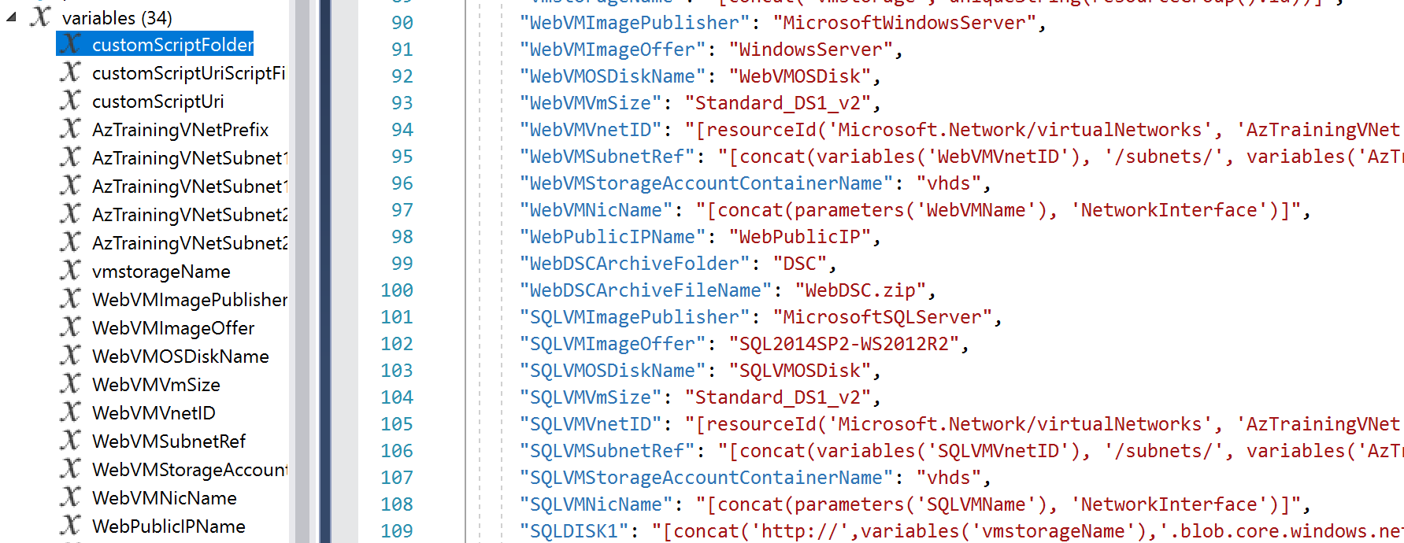
Basic Template Structure: Variables
The variables section contains references to settings, mostly picked up by the resources section later on, making definitions easier

Slide 23
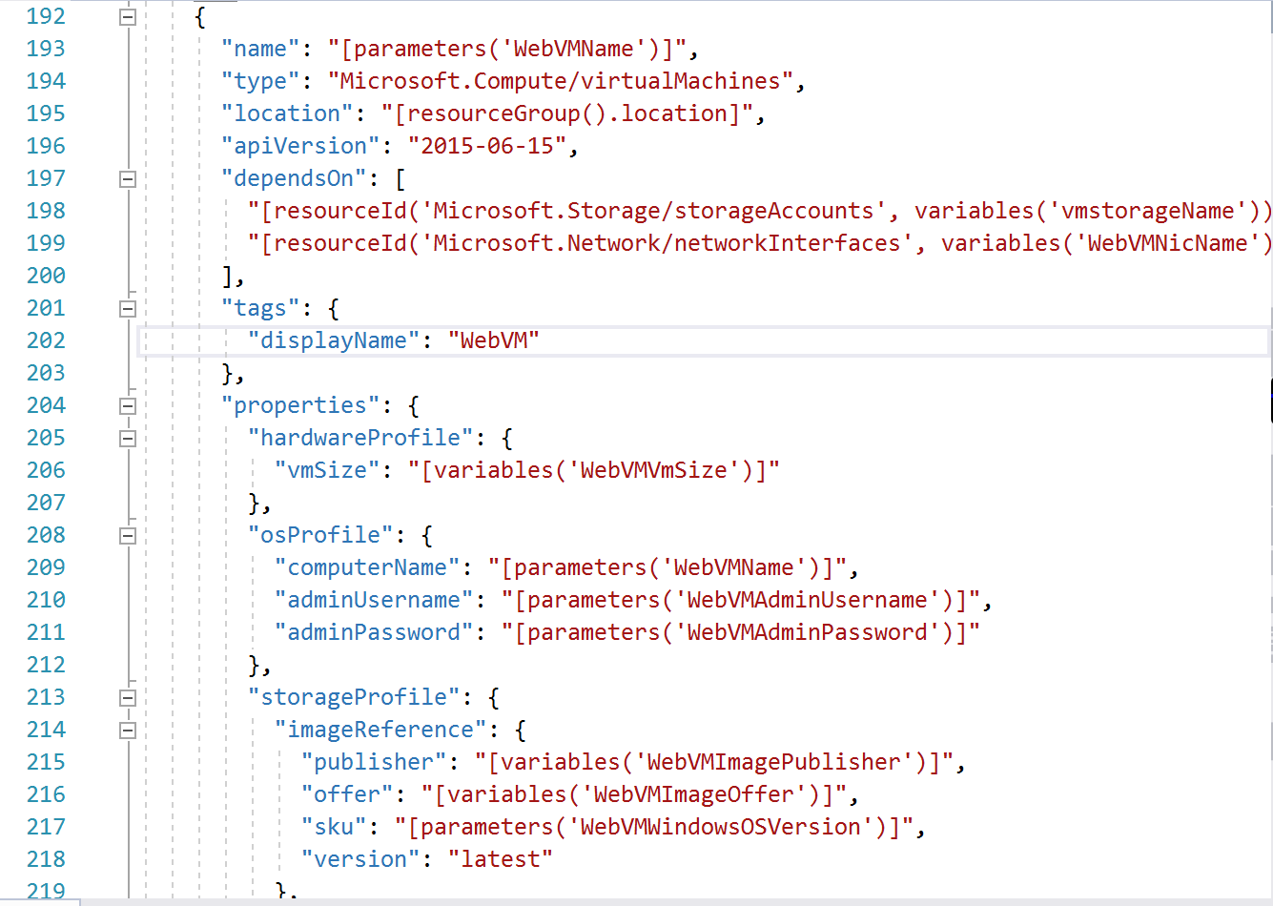
Basic Template Structure: Resources
The resources section defines each resource to be deployed, with references to parameters and variables as necessary. The elements which are defined vary based on the kind of resource which is being deployed.

Slide 24
Basic Template Structure: Resources (typical)
Location: You might be tempted to create a parameter for Location. However, a better practice is to inherit the location from the resource group
Type: The Type element for a resource is a combination of Resource Provider (discussed before) plus the Resource Type (ex: Microsoft.sql/servers)
Comments: Helpful info to clarify what the resource is, or what it’s being used for.
DependsOn: This helps Azure understand dependencies, so it can deploy resources in parallel, or sequentially, as appropriate
API Version: A version is specified for each resource which is associated with a version of the REST API. The version impacts which elements can be specified for the resource, so the versions are updated on occasion

Slide 25
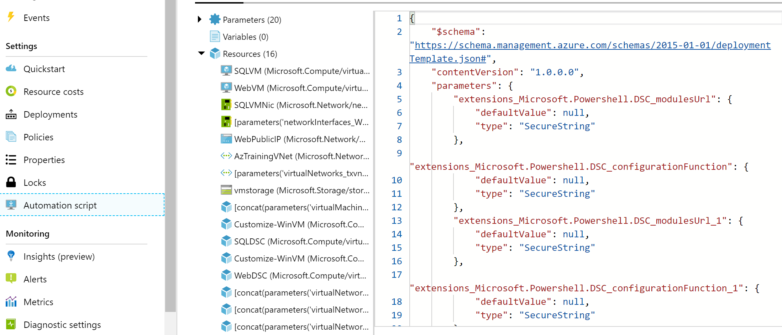
Azure Automation Script – Resource Group Export

Slide 26
Demo
Azure Automation Script

Slide 27
Questions
Landing
Spot
“…If you want good answers, ask better questions…”
© Randy Glasbergen

Slide 28
Azure Automation Script – Resource Group Export - Challenges
The value is part of the parameter name. Ex: if you have a web app named “007FFFWebAppDemo” it will generate a parameter called “sites_ 007FFFWebAppDemo _name.”
Not all resources can be scripted out in this manner yet. (You’ll see a message at the top of the template pane when this occurs)
Default values are overused
The admin password (when required) is not parameterized
There are a few inaccurate values that come out, which result in deployment failures when reusing the template as-is

Slide 29
ARM Templates flow to get kickstarted
Use Visual Studio 2017/2019 as your « authoring » environment
Split out parameter file in a separate parameters.azuredeploy.json
Fine-tune parameters according your needs
Matching naming conventions
Add metadata description for each parameter
Add parameters for anything that could vary between environments (dev, test, customer A, customer B,…)
NEVER store passwords as cleartext (rather securedstring with prompt or integrate with Azure Key Vault)
Add variables where they make sense
Fine-tune the Resources section
Use Resource Group inherited location
Use Tags (in relation to Azure Policies)

Slide 30
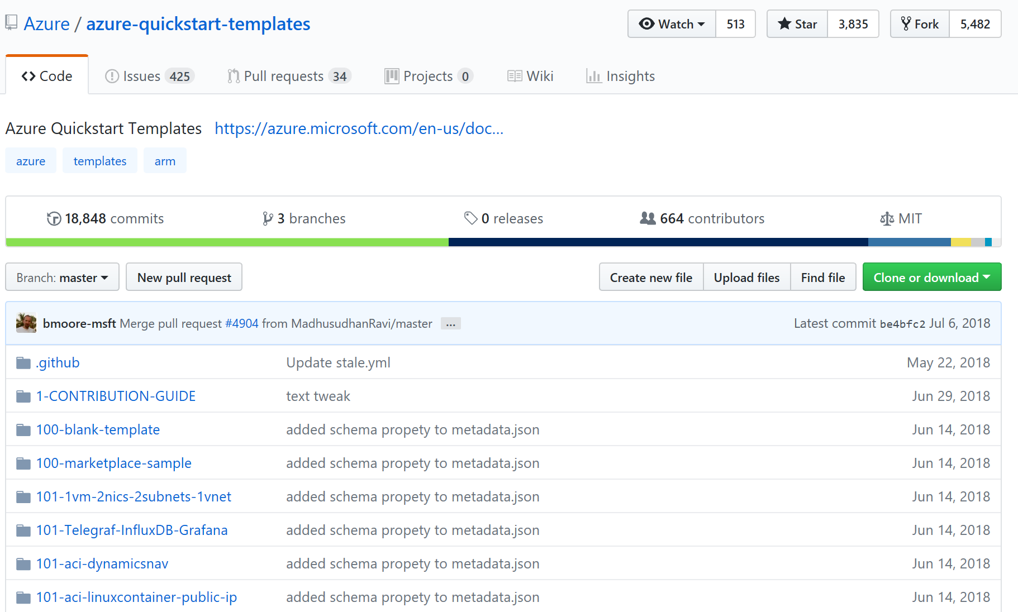
ARM Templates – GitHub Quickstart Templates
http://www.github.com/Azure/Quickstart-Templates

Slide 31
Demo
Azure QuickStart Templates

Slide 32
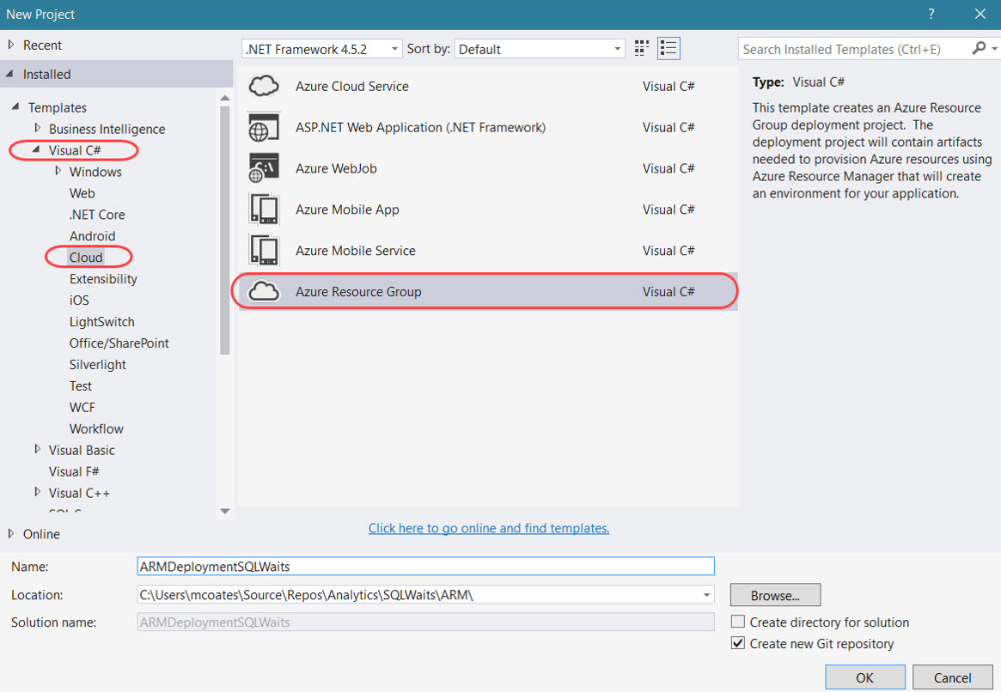
Create an ARM Project in VS2017 / VS2019
If you don’t see this option, it means the Azure SDK has not been installed yet

Slide 33
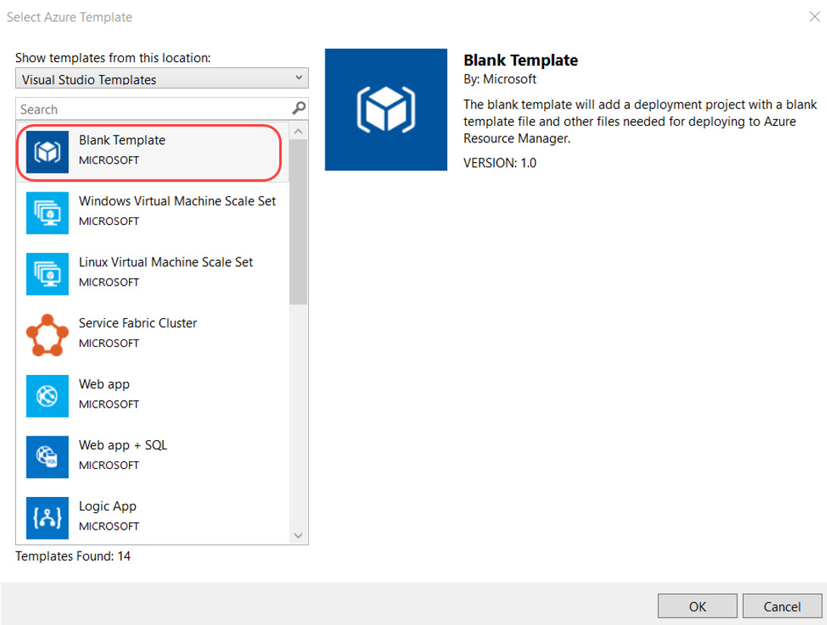
Create an ARM Project in VS2017
Start from a Blank Template or use any of the GitHub QuickStart Templates

Slide 34
Demo
Authoring ARM Templates using Visual Studio 2019

Slide 35
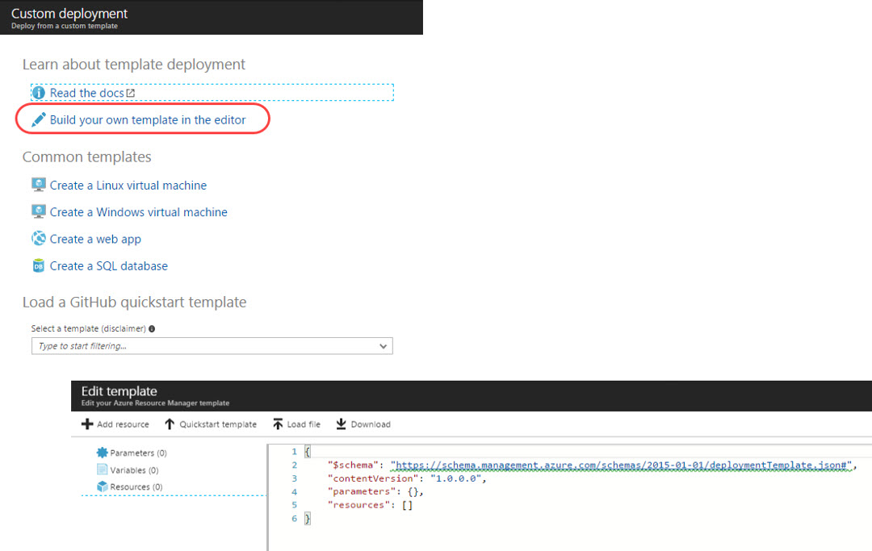
Running a template deployment from the Azure Portal
Add Resource / Template Deployment

Slide 36
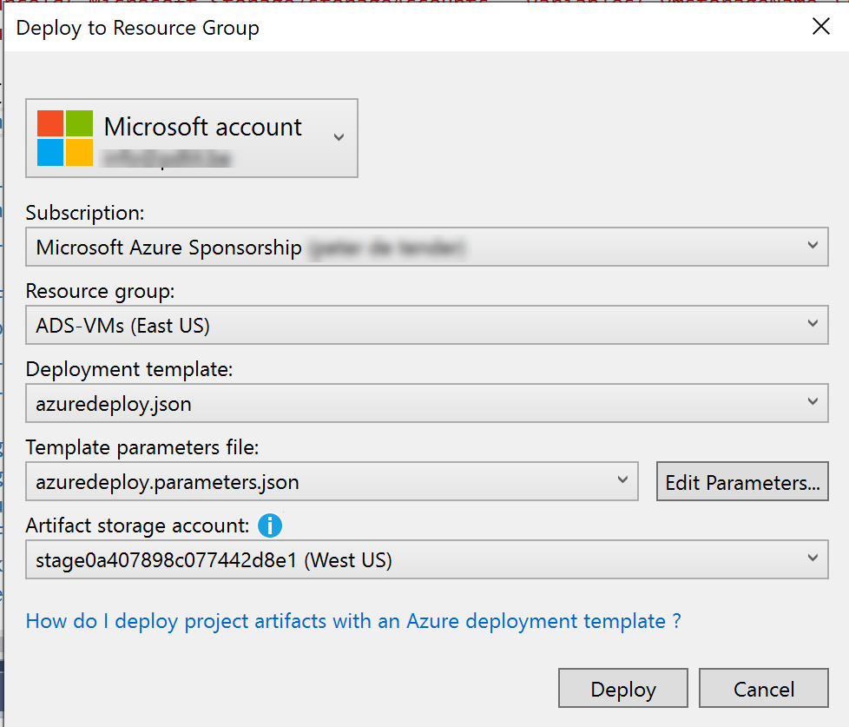
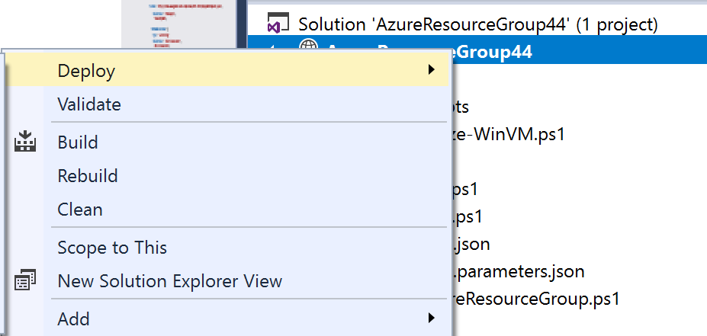
Running a template deployment from VS2017/VS2019

Slide 37
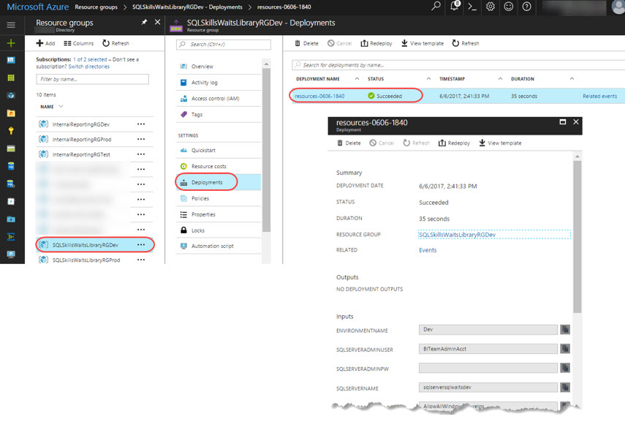
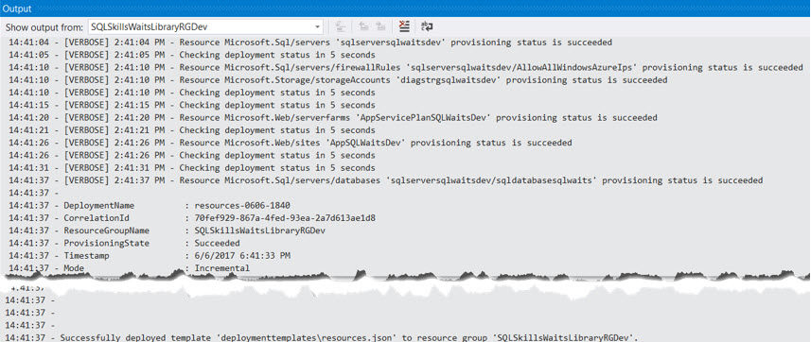
Monitoring ARM template deployment status
Azure Portal
Visual Studio Output

Slide 38
Demo
Monitoring ARM Template Deployment

Slide 39
VM Lift & Shift Migration using Azure Migrate

Slide 40
Azure Migration Experience: Unified and Extensible
Migrate*
Rehost
lift-and-shift
Optimize
Refactor
Assess
Rearchitect
Secure & Manage
Rebuild
*These migration strategies are adopted from Gartner research. Gartner also calls out a 5th strategy called “Replace” with SaaS
Notes:
BRK3055

Slide 41
Azure Migration Experience: Unified and Extensible
Migrate*
Rehost
lift-and-shift
Optimize
Refactor
Assess
Rearchitect
Secure & Manage
Rebuild
*These migration strategies are adopted from Gartner research. Gartner also calls out a 5th strategy called “Replace” with SaaS
Notes:
BRK3055

Slide 42
Workloads Migrations Matrix
Migration Type | Rehost (lift and shift | Refactor | Revise | Rebuild | Replace
Complexity | Moderate to Complex | Moderate to Complex | Moderate to Complex | Complex | Moderate
Example Workloads | RDS, Web Applications, Database | RDS, Web Applications | Legacy Applications, Databases | Legacy Applications | Legacy Applications
Tooling Capabilities | Extensive (First and 3rd party) | Several (First and 3rd party) | Minimal (First and 3rd party) | Extensive (First and 3rd party) | NA
Benefits | Proven, Quick and Container Support | Semi-Optimized and Container Support | Optimized, Container Support and PaaS enabled | Fully Optimized, Containerized and PaaS enabled | State of the Art, SaaS, HA, BCDR enabled.
DevOps / Automation | Moderate (Automation) | Moderate (Automation, Continuous Delivery) | Moderate (Automation, CI/CD) | Maximum (Automation, CI/CD) | NA

Slide 43

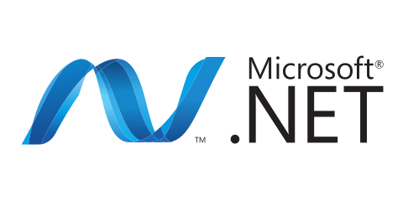





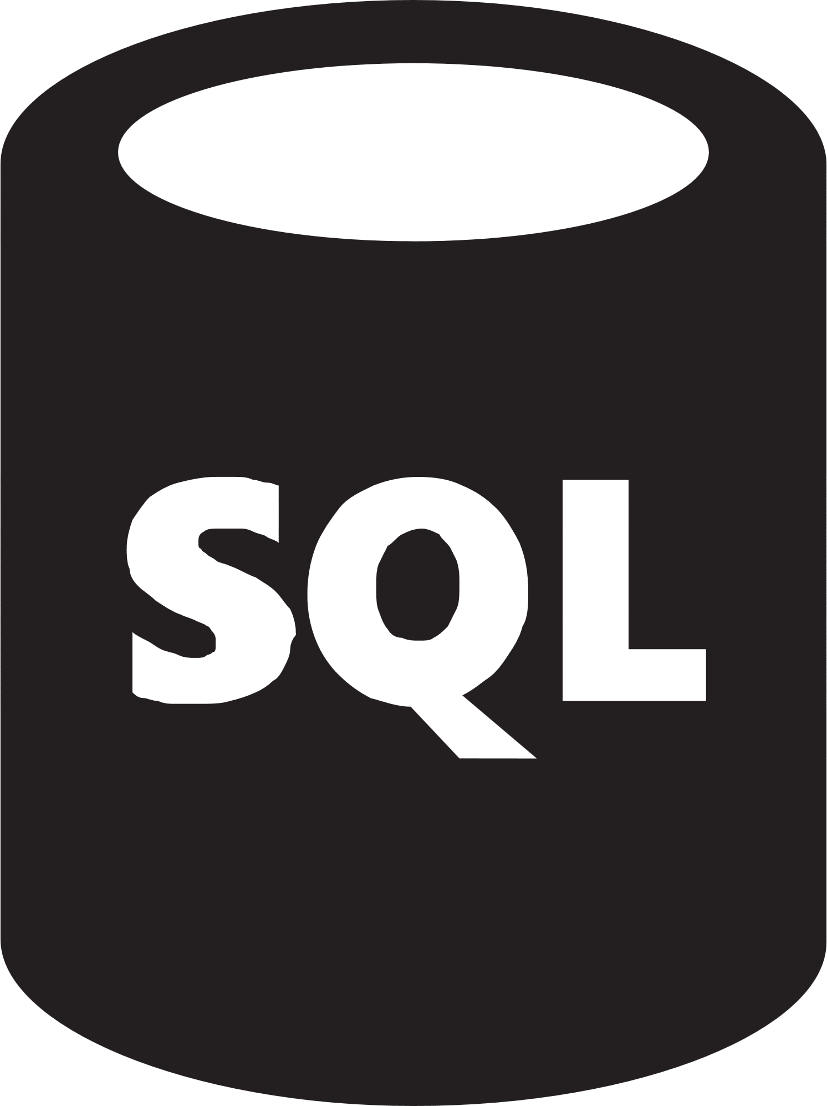

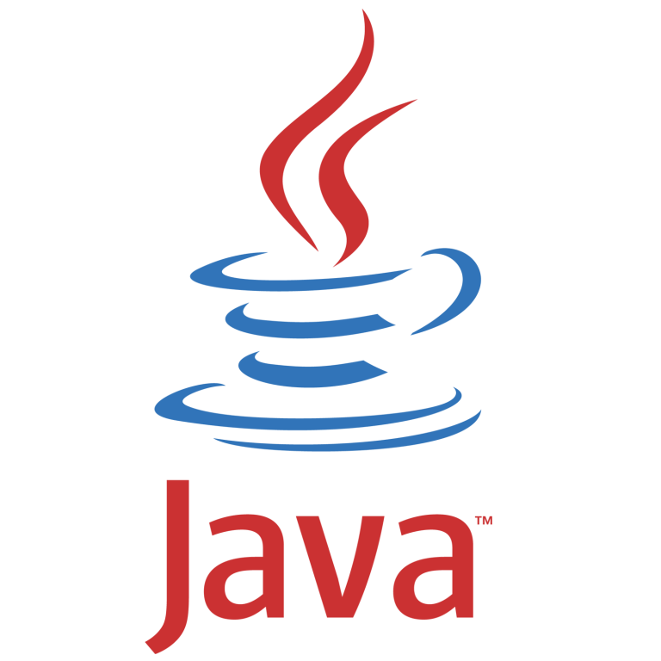
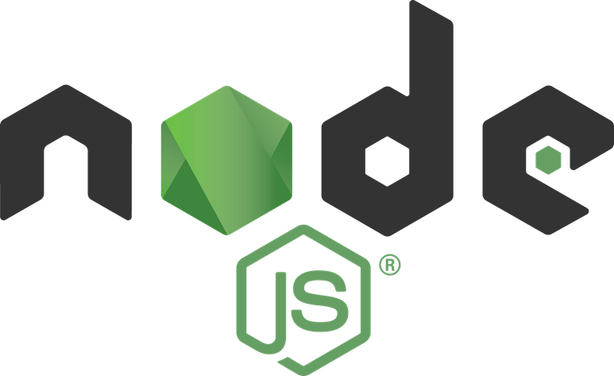


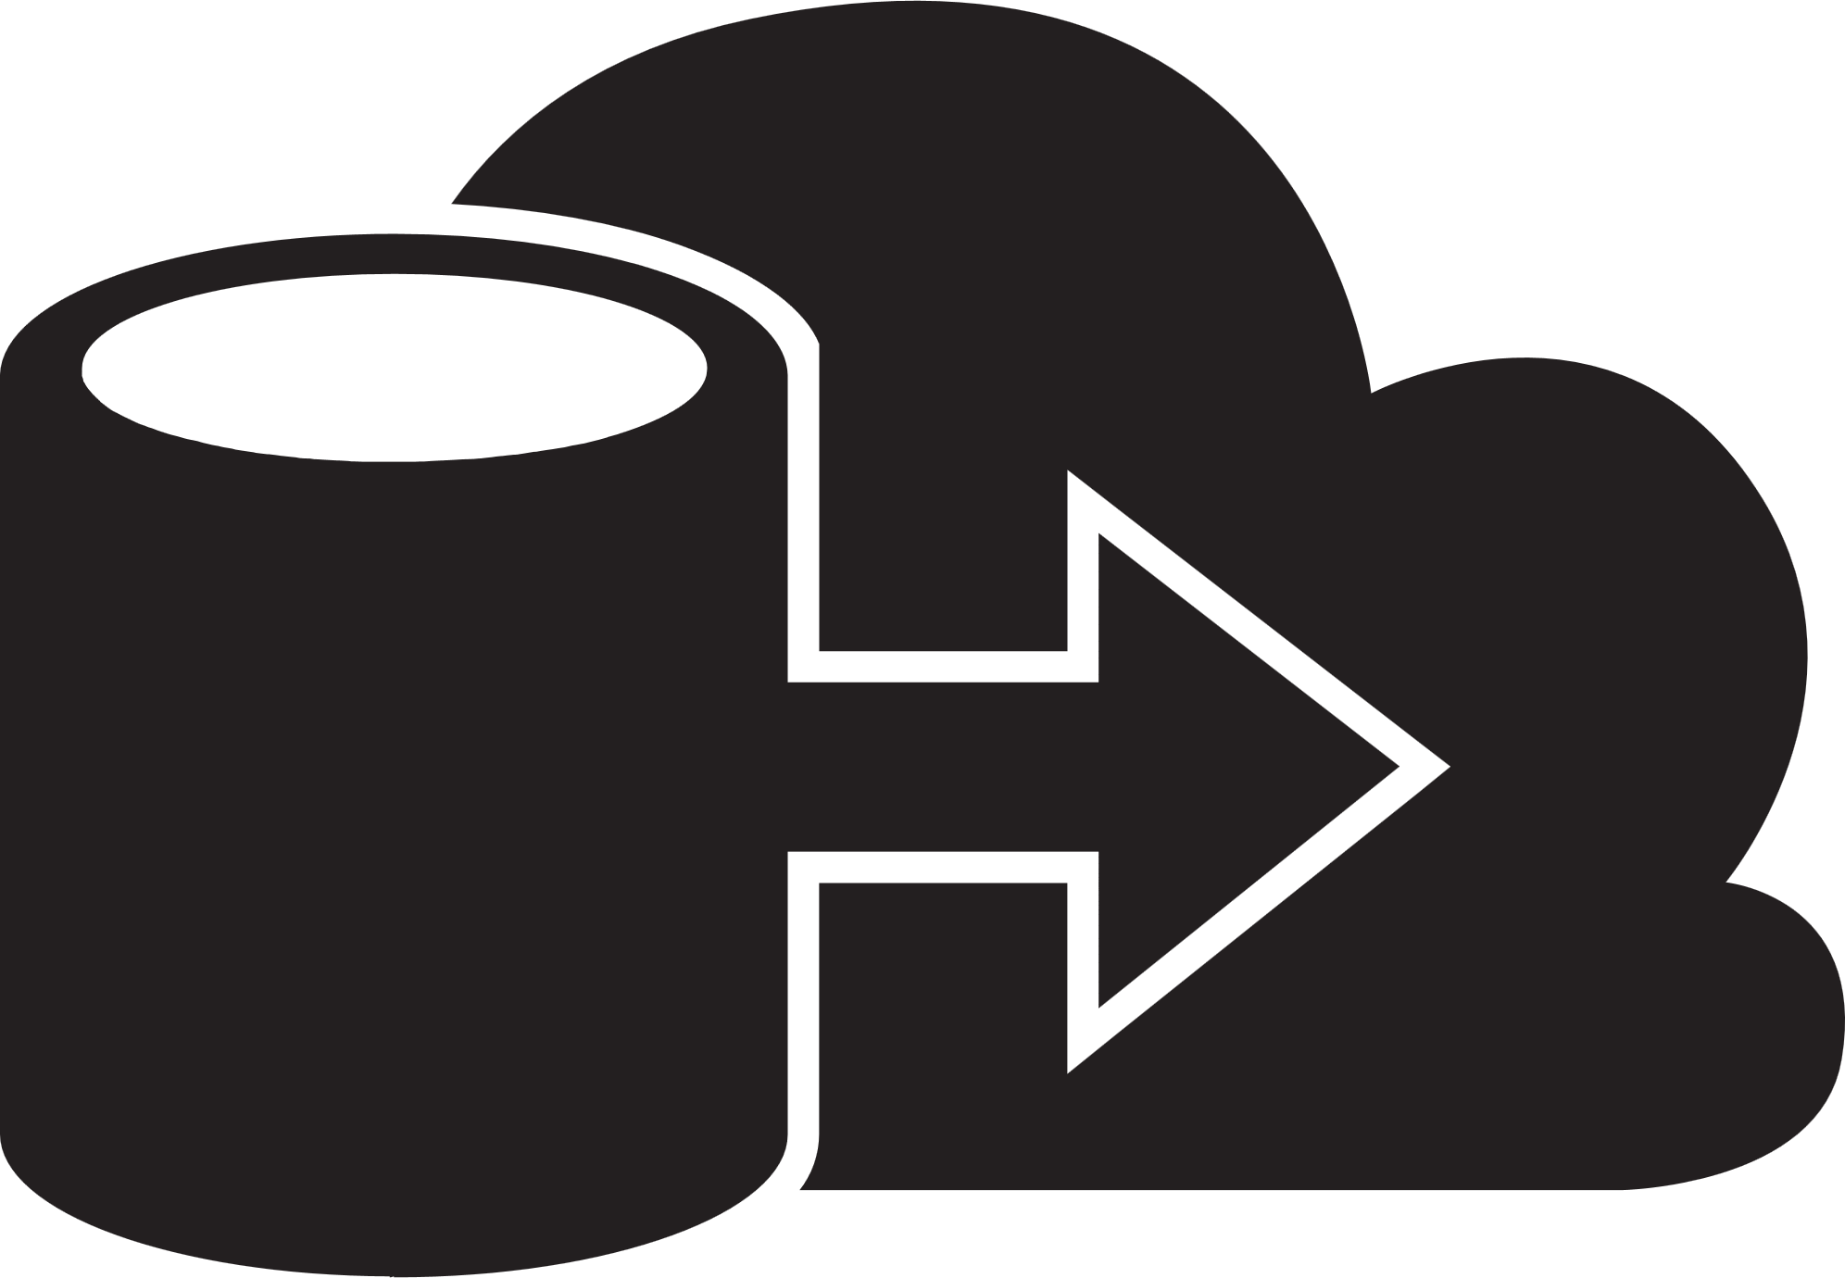
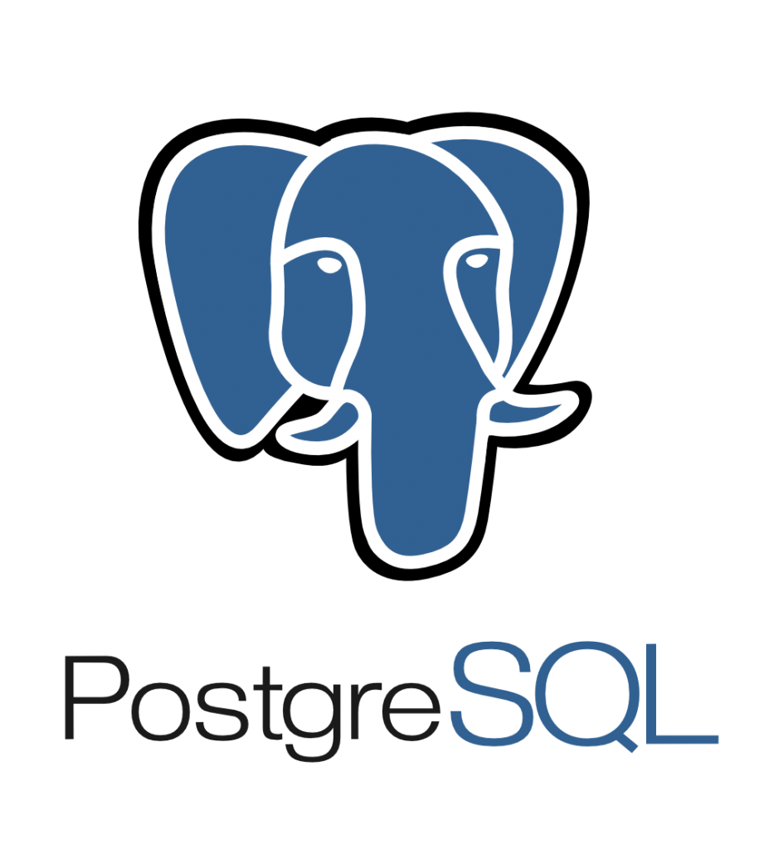
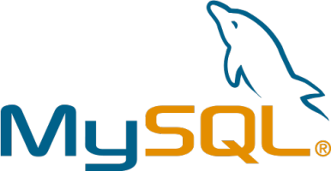


Migration strategies: Rehost application (i.e., lift & shift)
Sample illustration
On-premises
Azure
What is it?
Redeploy an existing application to a cloud platform without modifying its code. The application is migrated “as is”, which provides baseline cloud benefits without the risk or costs of making code changes.
When to use
Need to quickly move applications from on-premises to the cloud (e.g., datacenter contract expiry)
When the application is needed, but evolving its capabilities isn’t a business priority
For applications which are architected to leverage Azure IaaS scalability
Specific application or database requirements which can only be met by Azure VMs
Example
Move a line of business application to Azure VMs
Application tier
Application tier
Rehost
(lift and shift)
Azure IaaS VMs
Data tier
Data tier
Refactor
Azure Site Recovery
SQL Server
(on Windows Server)
Azure SQL Database Managed Instance
Rearchitect
Application tier
Application tier
Azure IaaS VMs
Rebuild
Data tier
Azure Database Migration Service
Data tier
Azure Database for PostgreSQL/MySQL
Notes:
Azure services
Compute: VM, VM Scale Sets

Slide 44




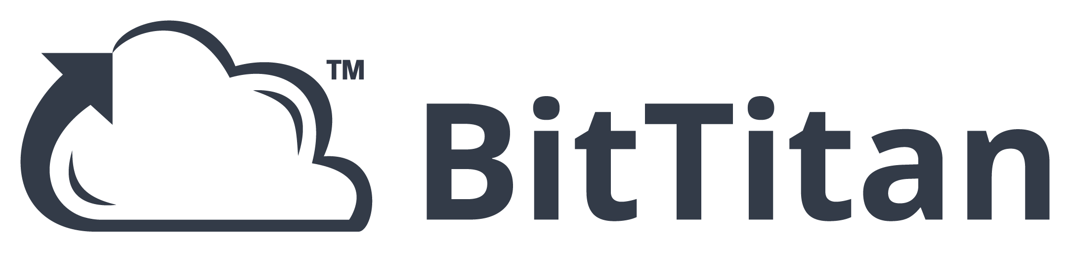



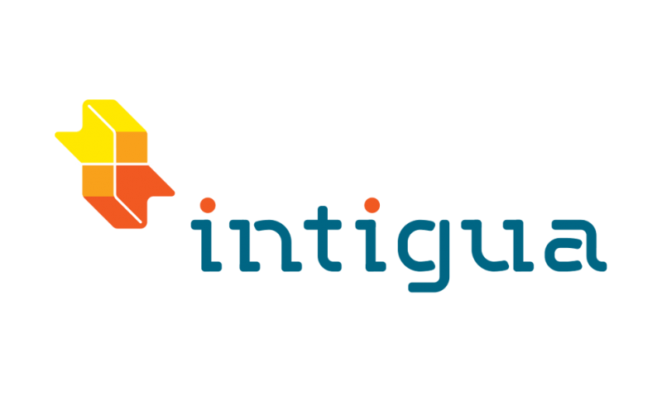
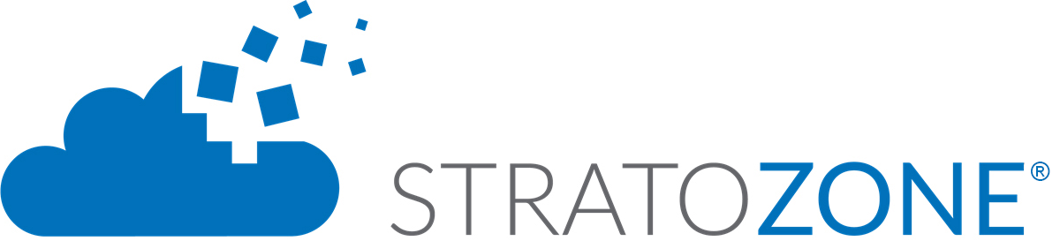







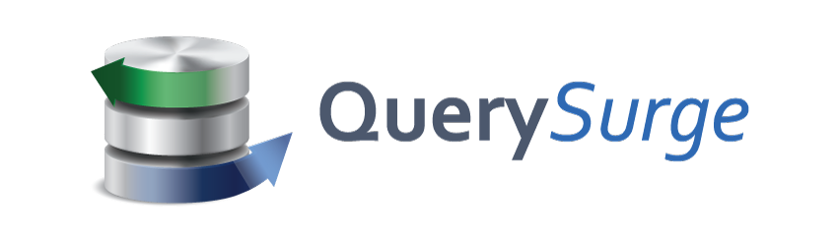
Choice of tools for every stage and every requirement
Assess
Migrate
Optimize
Secure & Manage
Azure Migrate
Azure Site Recovery (ASR)
Azure Cost Management
Azure Security & Management
(e.g., Blueprint, Security Center, Backup, Monitor)
Data Migration Assistant (DMA)
Azure Database Migration Service
SQL Server Migration Assistant (SSMA)
Azure Data Box
Partners
Notes:
Microsoft migration tools/services in action, aligned with the broader phases of the workload migration journey….Discover/Catalog/Assess → move and then keep stuff optimized post the move, be it secure/managed and cost-optimized.
We’d love your feedback on these terms…assessment
While we have numerous MSFT tools, we are working to make this better on two fronts:
stitch together experiences so customers don’t see the seams as they work from one phase to another.
consistent naming taxonomy consistency. Azure Migrate – its everything. ASR -.
And then we have a bunch of great ISV tools that attach to each phase of the journey – we’re in many cases actively working to integrate our first party tools with these.

Slide 45
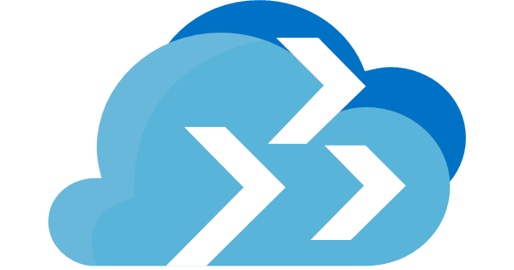



Choosing between 1st and 3rd party assessment tools
Use Azure Migrate when customer needs…
Use ISV tools when customer needs…
Use Azure Migrate when customer needs…
A Microsoft Azure branded tool which is free
Assessment of heterogeneous environments (physical, VMware and Hyper-V)
Agentless dependency visualization
Assessment of VMware environments¹
Cloud economics cost modelling
(including storage/networking costs)
Assessments of brand new Azure platform functionality
¹ Support for Hyper-V and physical servers is coming soon
Tools listed are recommendations, but not an exhaustive list. See azure.com/migration/partners for full list.

Slide 46



Azure Migrate – How it works
Raw metadata
Processed metadata
Appliance
Azure Migrate Service
Assessment
2. Start discovery
3. Create assessment
Raw metadata
vCenter Server
1. Download and configure appliance
Customer
vSphere server and VMs
Notes:
Timing precision?
Hit ISV assessment tools upfront in the deck. Using both in combination.

Slide 47
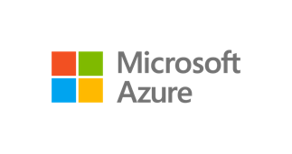
Azure Migrate v2
Unified migration platform: Use a single portal to start, run, and track your migration journey to Azure.
Range of tools: Azure Migrate provides native tools, and integrates with other Azure services, as well as with ISV tools. Select the right assessment and migration tools, based on your organizational requirements.
Azure Migrate Server Assessment: Use the Server Assessment tool to assess on-premises VMware VMs and Hyper-V VMs, for migration to Azure.
Azure Migrate Server Migration: Use the Server Migration tool to migrate on-premises VMware VMs, Hyper-V VMs, cloud VMs, and physical servers to Azure.
Azure Migrate Database Assessment: Assess on-premises databases for migration to Azure.
Azure Migrate Database Migration: Migrate on-premises databases to Azure.
Windows Server
Linux
Notes:
Timing precision?
Hit ISV assessment tools upfront in the deck. Using both in combination.

Slide 48
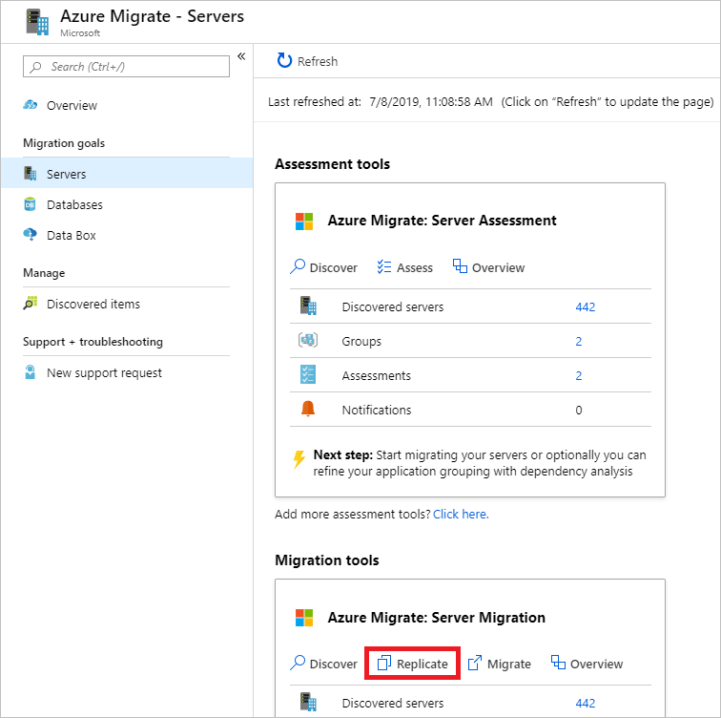
Replicate VMs
Azure Migrate project > Servers, Azure Migrate: Server Migration, click Replicate

Slide 49
Demo
VM Lift & Shift migration using Azure Migrate

Slide 50
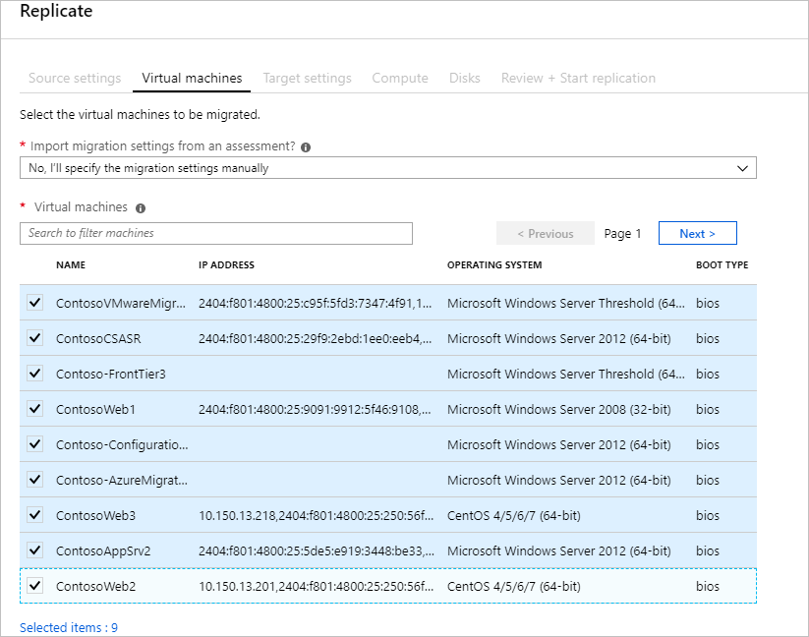
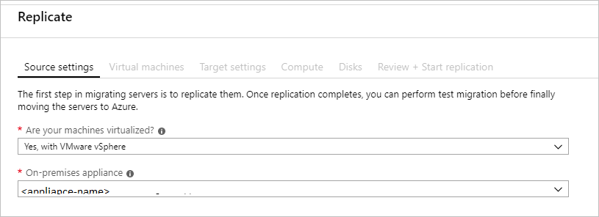
Select the source
Replicate, > Source settings > Are your machines virtualized?, select Yes, with VMware vSphere.

Slide 51
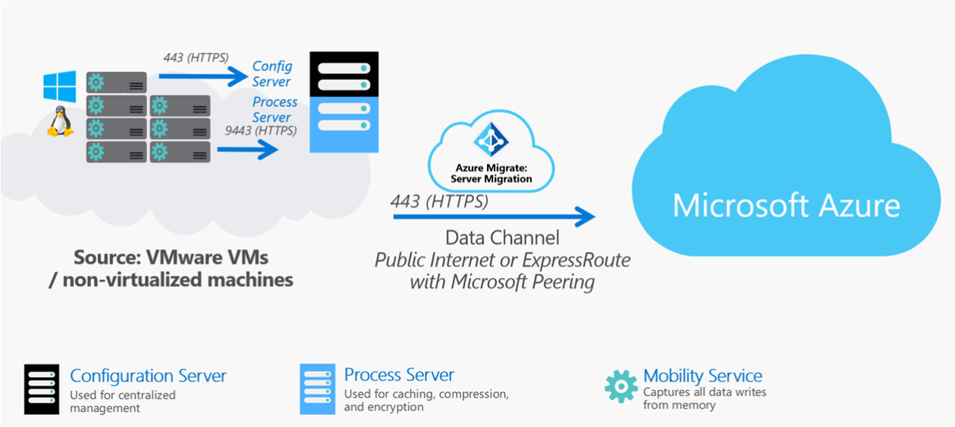
Agent based Server Migration Architecture (VMware, AWS, Physical)
Notes:
https://docs.microsoft.com/en-us/azure/migrate/agent-based-migration-architecture#server-migration-and-azure-site-recovery
The table summarizes the components used for agent-based migration.
ComponentDetailsInstallation
Replication applianceThe replication appliance (configuration server) is an on-premises machine that acts as a bridge between the on-premises environment, and the Azure Migrate Server Migration tool. The appliance discovers the on-premises VM inventory, so that Azure Server Migration can orchestrate replication and migration. The appliance has two components: Configuration server: Connects to Azure Migrate Server Migration and coordinates replication. Process server: Handles data replication. It receives VM data, compresses and encrypts it, and sends to the Azure subscription. There, Server Migration writes the data to managed disks.By default the process server is installed together with the configuration server on the replication appliance.
Mobility serviceThe Mobility service is an agent installed on each machine you want to replicate and migrate. It sends replication data from the machine to the process server. There are a number of different Mobility service agents available.Installation files for the Mobility service are located on the replication appliance. You download and install the agent you need, in accordance with the operating system and version of the machine you want to replicate.

Slide 52
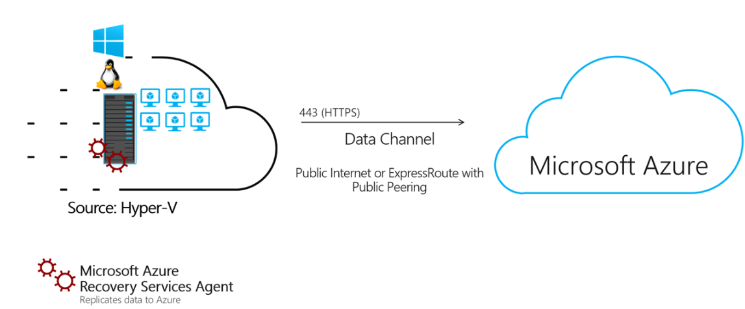
Agent based Server Migration Architecture (Hyper-V)
Notes:
Component Deployment
https://docs.microsoft.com/en-us/azure/migrate/hyper-v-migration-architecture#architectural-components
Replication providerThe Microsoft Azure Site Recovery provider is installed on Hyper-V hosts, and registered with Azure Migration Server Migration. The provider orchestrates replication for Hyper-V VMs.
Recovery Services agent The Microsoft Azure Recovery Service agent handles data replication. It works with the provider to replicate data from Hyper-V VMs to Azure. The replicated data is uploaded to a storage account in your Azure subscription. The Server Migration tool the processes the replicated data, and applies it to replica disks in the subscription. The replica disks are used to create the Azure VMs when you migrate.
Components are installed by a single setup file, downloaded from Azure Migrate Server Migration in the portal.
The provider and appliance use outbound HTTPS port 443 connections to communicate with Azure Migrate Server Migration.
Communications from the provider and agent are secure and encrypted.
Replication process
When you enable replication for a Hyper-V VM, initial replication begins.
A Hyper-V VM snapshot is taken.
VHDs on the VM are replicated one-by-one, until they're all copied to Azure. Initial replication time depends on the VM size, and network bandwidth.
Disk changes that occur during initial replication are tracked using Hyper-V Replica, and stored in log files (hrl files).
Log files are in the same folder as the disks.
Each disk has an associated hrl file that's sent to secondary storage.
The snapshot and log files consume disk resources while initial replication is in progress.
After initial replication finishes, the VM snapshot is deleted, and delta replication begins.
Incremental disk changes are tracked in hrl files. Replication logs are periodically uploaded to an Azure storage account by the Recovery Services agent.

Slide 53
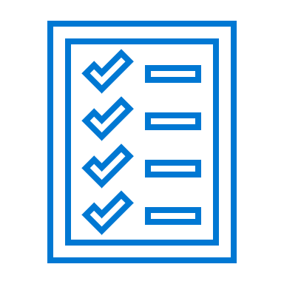
Azure Site Recovery for Azure IaaS VMs Lift & Shift Migration
1
No-impact DR testing
2
Meet your RPO and RTO SLAs
Ensure compliance
3
Centralized monitoring and alerting

Slide 54
Azure Site Recovery for Azure IaaS VMs Lift & Shift Migration
1
One-click replication
2
Simple
One-click VM Migration

Slide 55


Azure Site Recovery for Azure IaaS VMs Lift & Shift Migration
Zero application data loss during migration
Near-zero application downtime during migration
Broad coverage for hypervisors, applications, operating systems, and Azure features
No-impact application testing in Azure

Slide 56


Azure Site Recovery for Azure IaaS VMs Lift & Shift Migration
Azure Site Recovery
DR Orchestration
DR Orchestration
Azure Storage
Azure VMs
SQL Backend
ASR Replication
App Front End
App Tier
ASR Replication
Active Directory
ASR Replication
Primary Site
Azure

Slide 57
Azure Site Recovery for Azure IaaS VMs Lift & Shift Migration
Azure Site Recovery
DR Orchestration
DR Orchestration
Azure Storage
Azure VMs
SQL Backend
SQL Availability Group
App Front End
App Tier
ASR Replication
Active Directory
AD & ASR Replication
S2S VPN
Azure
Primary Site
S2S VPN

Slide 58
Demo
Use Azure Site Recovery for Lift & Shift VM Migration

Slide 59
Section Take-Aways
Infrastructure as Code (IAC) allows you to deploy Azure resources in an automated, repeatable way
Azure Migrate (v2) is recommended for agent-less migration – of VM Lift & Shift scenarios
Azure Site Recovery (ASR) performs the actual VM replication process, and can be used out of Azure Migrate, or as a stand-alone service for Lift & Shift migrations

Slide 60
Questions
Landing
Spot
“…If you want good answers, ask better questions…”
© Randy Glasbergen

Slide 61
Next Module…
(SQL) Database Migration
@pdtit @007FFFlearning

Slide 62
Thank You

